Slide 1
How I Learned to Stop Empiricising and Love my Intuitions Or: Why corpus research is like a tornado
Dougal Graham – dougal.gra@kmutt.ac.th

Slide 2
Me & My Research
Computational background
Academic Formulas List (Simpson-Vlach, et al, 2010)
AFL for Engineering English

Slide 3
Q
In which genre (spoken, fiction, newspaper, academic) is shall used most and in which the least, compared to will?
Put the following verbs in order of frequency (high to low): promise, shine, finish, enable, jump.
Which of the following would occur more frequently with little, and which with small: success, plate, hill, baby, impact, pieces, wonder, distance.
(Davies, 2011)
Notes:
A. In both British (BNC) and American (COCA) corpora, shall is found most
in fiction, and least in newspaper (possibly a surprise for those who expected
that it would be spoken).
D. Raw frequencies in American English: finish (41663), jump (27433), promise
(24799), enable (15762) and shine (8617).
F. From COCA (American English):
little: success, baby, impact and distance;
small: plate, hill, pieces and wonder.

Slide 4
Empirical approaches
Phrase research: “as shown in chapter”
Phrase list plus…
Empirical metrics:
Frequency
Range
Mutual Information
LL
FTW (Simpson-Vlach et al, 2010)
Notes:
FTW is a measure of psycholinguistic saliency
- Explain the method

Slide 5
Results
Three Words | Four Words | Five Words
what is the | can be used to | at a rate of #
the number of | as a function of | you should be able to
as shown in | the magnitude of the | beyond the scope of this
# and # | as shown in figure | how long will it take
can be used | with respect to the | the first law of thermodynamics
shown in figure | in this chapter we | in such a way that
the value of | the value of the | the rate of change of
Notes:
Some of these are useful
Some less so

Slide 6
Intuitively…
Results not so useful
Goal: “A useful list of formulaic Eng. phrases”
Re-visit metrics
Frequency
Range
Mutual Information
LL
FTW (Simpson-Vlach et al, 2010)
Notes:
F -> high frequency language is language students will encounter and need to understand
R -> Useful for a wider range of situations and students
MI -> Is formulaic…
LL -> Is Engineering Language
FTW -> Useful for teaching? (This did not really improve my results...)

Slide 7
Re-evaluation
Intuitively, the results weren’t useful
Confusion
Martinez & Schmitt’s PHRASE List
Intuitive criteria
Notes:
Thought about other empirical approaches
Tried many statistics (or, range, etc…)
Nothing worked
Confusion…
Return to reading

Slide 8
Problems
AFL approach
results not sufficiently useful
are the assumptions warranted?
PHRASE List approach
Criteria very intuitive
Hand-sorting 15,000 items
Notes:
- The AFL ASSUMES that MI and/or frequency should be tied to intuitive judgments of usefulness for teaching
(one of 3 intuitive criteria, the other being unitarity)
Is this a reasonable assumption?
M&S
Consider a leaner’s perspective
Eg: deceptive transparency (‘for some time’ means a long time, not short)
Eg: L1 effects (‘nothing out there’, in Spanish is said as ‘nothing around’)

Slide 9
Liking my intuitions
Needs to be useful for learners
Should be difficult language
How can we determine the language that will be difficult?
Notes:
What does that mean?
Maybe we can refine it to difficult.
But difficult how?

Slide 10
Results
Three Words | Four Words | Five Words
what is the | can be used to | at a rate of #
the number of | as a function of | you should be able to
as shown in | the magnitude of the | beyond the scope of this
# and # | as shown in figure | how long will it take
can be used | with respect to the | the first law of thermodynamics
shown in figure | in this chapter we | in such a way that
the value of | the value of the | the rate of change of
Notes:
Some of these are useful
Some less so

Slide 11
Semi-empirical
marked part of speech
“for a given”
marked word form
“is known as”
marked collocations
“under the action of”
Notes:
Most common part of speech for “given” is V, not Adj
Know, is much more common than “known”
“under” is not a common prepositional collocate for “action”, or even “the action” (“pursuant” and “due” are the most common)
But these were not sufficient to describe all the phrases which I intuited to be useful

Slide 12
Semi-Intuitive
non-prototypical word meaning
“let us consider”
non-literal phrase meaning
“we can write”
specialized syntax
“let X be”
Notes:
So I added some more intuitive criteria
Use of “let” does not really mean “allow” here
Actually we can write anything
Subjunctive

Slide 13
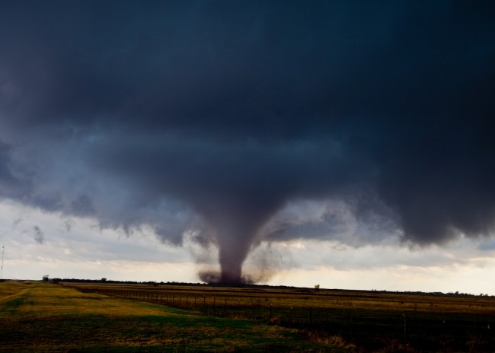
Intuition
Empiricism
1. Empiricism
2. Intuitive re-evaluation
3. Semi-empirical criteria
4. Semi-intuitive criteria
5. Results
Notes:
So, to review, I start with empiricism, moved to intuition, when it didn’t do what I wanted.
Then, I was able to use my intuitions to come up with more empirical criteria
But that still wasn’t enough, so I came up with with more intuitive criteria

Slide 14
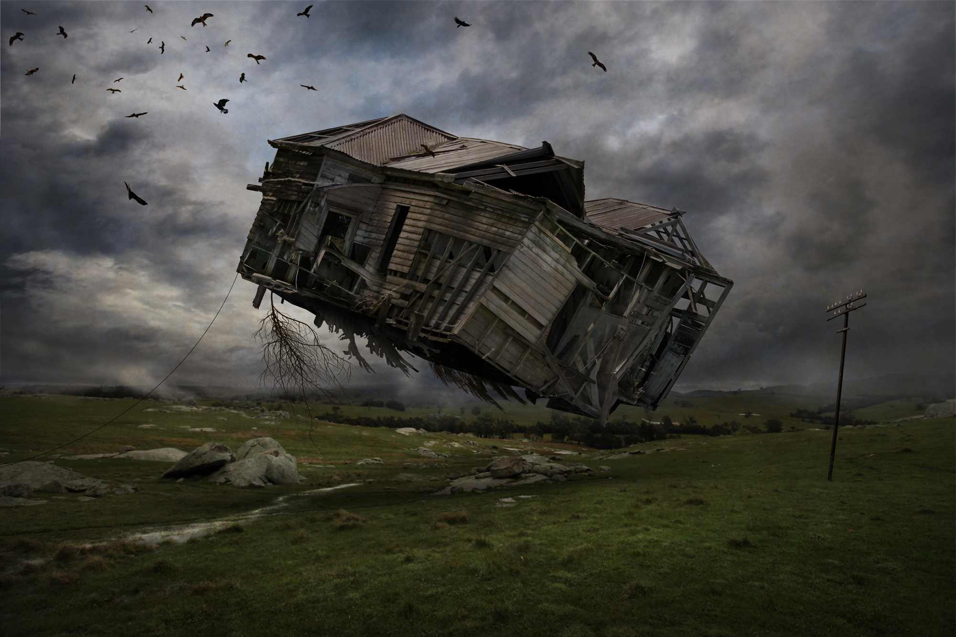
Embrace the tornado
Notes:
This can be frightening and confusing
BUT, embrace the tornado

Slide 15
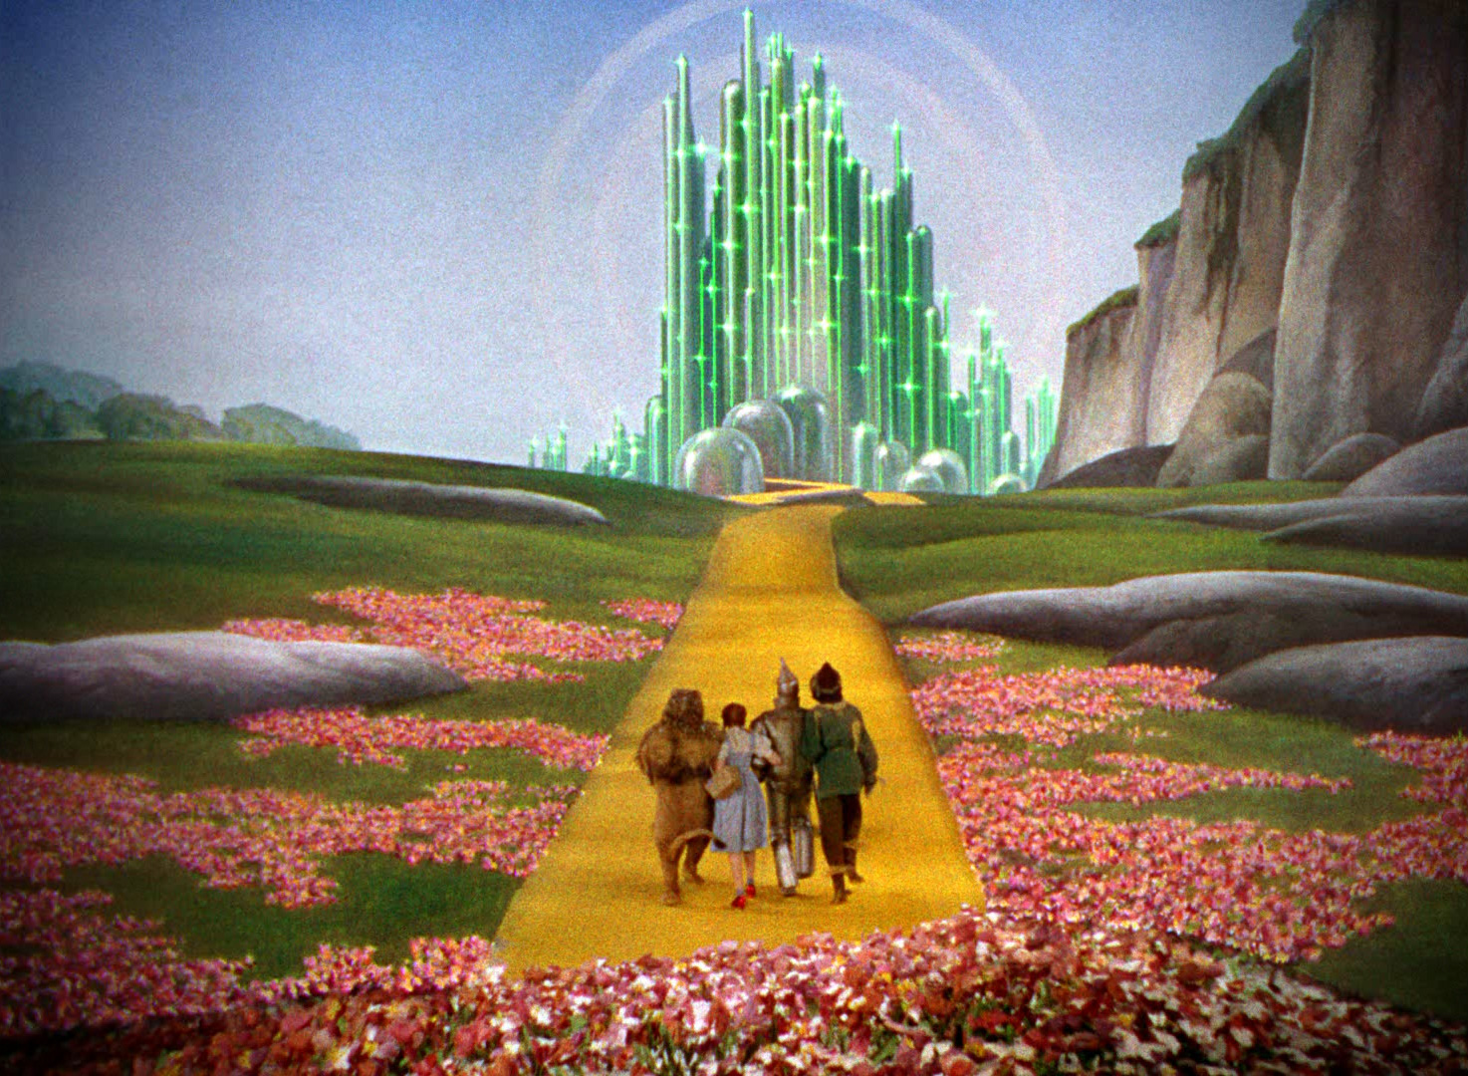
Notes:
- But in the end you’ll be in a magical new world, I hope

Slide 16
Final Points
Embrace the tornado
Iterative design
Precision vs. Recall
Notes:
Are MI and frequency the best cognitive measures of “usefulness for teaching”? Or, are they just easily calculated?
Be willing to go against your natural inclinations and find alternative approaches, use iterative design
Constantly refining your process, results, etc.
Precision versus recall
M&S high recall, low precision (1 in 29) ← they could have used another statistic to help
Simpson-vlach, unclear, but I’d say low precision, low recall (for my results)
My criteria (1 in 14)

Slide 17
Selected References
Davies, M. (2011). Synchronic and diachronic use of corpora. In V. Viana, S. Zyngier, & G. Barnbrook (Eds.), Perspectives on corpus linguistics (Vol. 48, pp. 63–80). John Benjamins Publishing.
Martinez, R., & Schmitt, N. (2012). A Phrasal Expressions List. Applied Linguistics, 33(3), 299–320.
Simpson-Vlach, R., & Ellis, N. C. (2010). An Academic Formulas List: New Methods in Phraseology Research. Applied Linguistics, 31(4), 487–512. doi:10.1093/applin/amp058

